Slide 1
Cloud Computing
SEWP ZG527

Slide 2
SaaS – Agenda
What is SaaS?
Traditional Model
How is it delivered?
SaaS Architecture
SaaS Models
Advantages of SaaS
User and Vendor benefits of SaaS
2

Slide 3
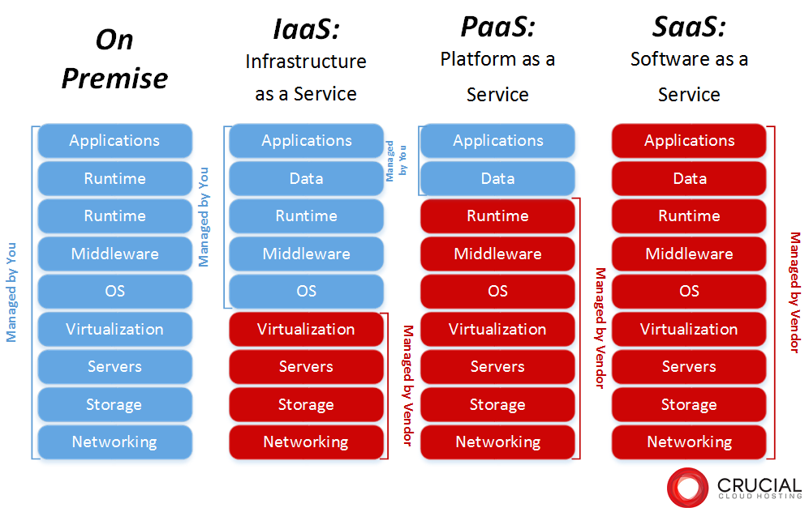
Dependency on IaaS and PaaS
Notes:
RL 5.1

Slide 4
What is SaaS?
Software as a service is a software distribution model in which applications are hosted by a vendor or service provider and made available to customers over a network, typically the Internet.
Shortly, in the SaaS model software is deployed as a hosted service and accessed over the Internet, as opposed to “On Premise.”
Software delivered to home consumers, small business, medium and large business
The traditional model of software distribution, in which software is purchased for and installed on personal computers, is sometimes referred to as software as a product.

Slide 5
Problems in traditional Model
In the traditional model of software delivery, the customer acquires a perpetual license and assumes responsibility for managing the software.
There is a high upfront cost associated with the purchase of the license, as well as the burden of implementation and ongoing maintenance.
ROI is often delayed considerably, and, due to the rapid pace of technological change, expensive software solutions can quickly become obsolete.

Slide 6
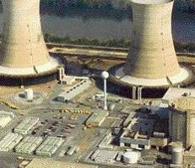
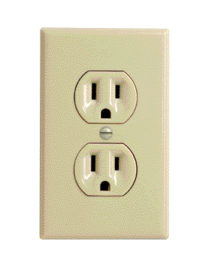
Problems in traditional Model
Traditional Software
On-Demand Utility
Plug In, Subscribe Pay-per-Use
Build Your Own

Slide 7
SaaS – How is it delivered
The web as a platform is the center point. The web as a platform is the center point
Network-based access to, and management of, commercially available (i.e., not custom) software application delivery that typically is closer to a one-to-many model (single instance, multi-tenant architecture) than to a one-to-one model, including architecture, pricing, partnering, and management characteristics
Software delivered to home consumers, small business, medium and large business
The traditional model of software distribution, in which software is purchased for and installed on personal computers, is sometimes referred to as software as a product.

Slide 8
Thanks!!!
Queries?

